Slide 1
Graphing Techniques and Interpreting Graphs

Slide 2
Learning Objectives
I can explain the reasons/functions for using graphs.
I can interpret data on a scientific graph
I can describe data trends/relationships shown on a graph.
I can predict data using interpolation and extrapolation.

Slide 3
Why are graphs important?
What is the functions for graphs?

Slide 4
Introduction
A graph of your data allows you to see the following:
Patterns
Trends
Shows Relationships between the independent and dependent variables.
Shows visual representation of data

Slide 5
Numbering/Scaling

Slide 6
Variables
Independent Variable (I.V.)
Something the experimenter changes and is placed on the X – Axis.
Dependent Variable (D.V.)
Measured during the experiment and is placed on the Y – Axis.

Slide 7
Types of Data Relationships
Directly Related
Inversely Related

Slide 8
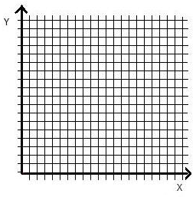
Directly Related or Direct Relationship
IV increases, DV increases or as IV decreases, DV decreases.
Positive trend on a graph
Math calls this a positive correlation

Slide 9
Inversely Related or Inverse Relationship
IV increases, DV decreases or as IV decreases, DV increases.
Negative trend on a graph
Math calls this a negative correlation

Slide 10
Trend Line or Line of Best Fit
A line that summarizes the data. This is sometimes called a best-fit line.
The line of best fit is drawn so that the points are evenly distributed on either side of the line
Data points do not have to be on this line or the line DOES NOT need to go through each point.
The data points are NOT connected with a line.
It DOES NOT have to go through the origin.

Slide 13
Ways to predict data
Interpolation - Predicting data that is inside the range of data (between 2 existing data points)
Extrapolation - Predicting values that are outside of the range of data. Trend line is often extended to make extrapolation easier.

Slide 14
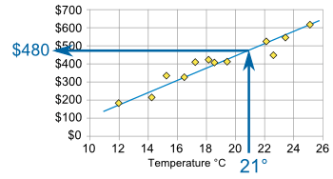
Interpolation
Predict data that is inside the range of data (between 2 existing data points)

Slide 15
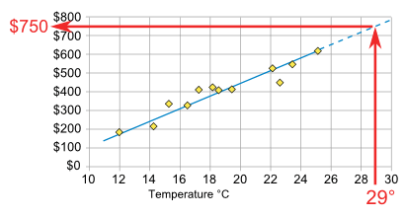
Extrapolation
Predicting values that are outside of the range of data. Trend line is often extended to make extrapolation easier.

Slide 16
Example – Predict the time at temperature 90.
Did you interpolate or extrapolate?
Why did you use this process?
Temperature (⁰C)
Time (Min)

Slide 17
Example – Predict the time at temperure 90.
87min
Did you interpolate or extrapolate?
Extrapolate
Why did you use this process?
Outside the data
Temperature (⁰C)
87 min
Time (Min)

Slide 18
Example – Predict the temperature at time 30. Did you interpolate or extrapolate? Why did you use this process?
Temperature (⁰C)
Time (Min)

Slide 19
Example – Predict the temperature at time 30.
28⁰C
Did you interpolate or extrapolate?
Interpolate
Why did you use this process?
Between 2 Points
Temperature (⁰C)
Point 1
28ºC
Point 2
Time (Min)

Slide 20
Big Ideas
Trend line or best fit line – A line that summarizes the data. Data points do not need to be on this line. The data points are NOT connected with a line
Data Relationships
Directly Related – IV increases , DV increases ; and vice versa
Inversely related – IV increases , DV decreases ; and vice versa
Data Prediction
Interpolation – predicting values that are within the range of available data (between existing data points)
Extrapolation – predicting values that are outside the range of data; a trend line is often extended.

